Slide 1
Secure data hiding in images using steganography
CAPSTONE PROJECT
Presented By: ANKIT GOPE
Student Name : ANKIT GOPE
College Name : BENGAL COLLEGE OF ENGINEERING AND TECHNOLOGY Department : INFORMATION TECHNOLOGY

Slide 2
OUTLINE
Problem Statement
Technology used
Wow factor
End users
Result
Conclusion
Git-hub Link
Future scope

Slide 3
Problem Statement
Traditional communication methods are prone to interception, making data security a concern. This project solves the issue by using steganography to hide secret messages inside images, ensuring covert and secure communication through a user-friendly React and Flask-based web app. The application allows users to encode messages within images and retrieve them using a decryption feature, providing an additional layer of security. With a simple and intuitive interface, users can securely share confidential information without drawing suspicion. This approach enhances privacy and ensures that sensitive data remains protected from unauthorized access.

Slide 4
Technology used
Frontend: React.js, Material UI, Tailwind CSS
Backend: Flask (Python)
State Management: React Hooks
Storage: File handling with Flask
.Library : Python cv2 Library
Security: Password-protected encoding/decoding

Slide 5
Wow factors
Secure Steganography – Password-protected message encoding and decoding.
Real-Time Image Preview – See your selected image before encoding/decoding.
Fast & Efficient – Optimized with Flask backend for quick processing.
Modern UI – Sleek and responsive interface with Material UI & Tailwind CSS.
Easy Accessibility – Web-based, no need for additional software.
Downloadable Encoded Image – Get your encoded image instantly.
Reset Fields Instantly – One-click reset for hassle-free testing.

Slide 6
End users
Individuals & Privacy Enthusiasts – Securely hide confidential messages within images.
Journalists & Activists – Protect sensitive information from surveillance.
Cybersecurity Professionals – Explore steganography for secure communication.
Students & Researchers – Learn and experiment with information hiding techniques.
Developers & Hobbyists – Understand the integration of steganography with web technologies.

Slide 7
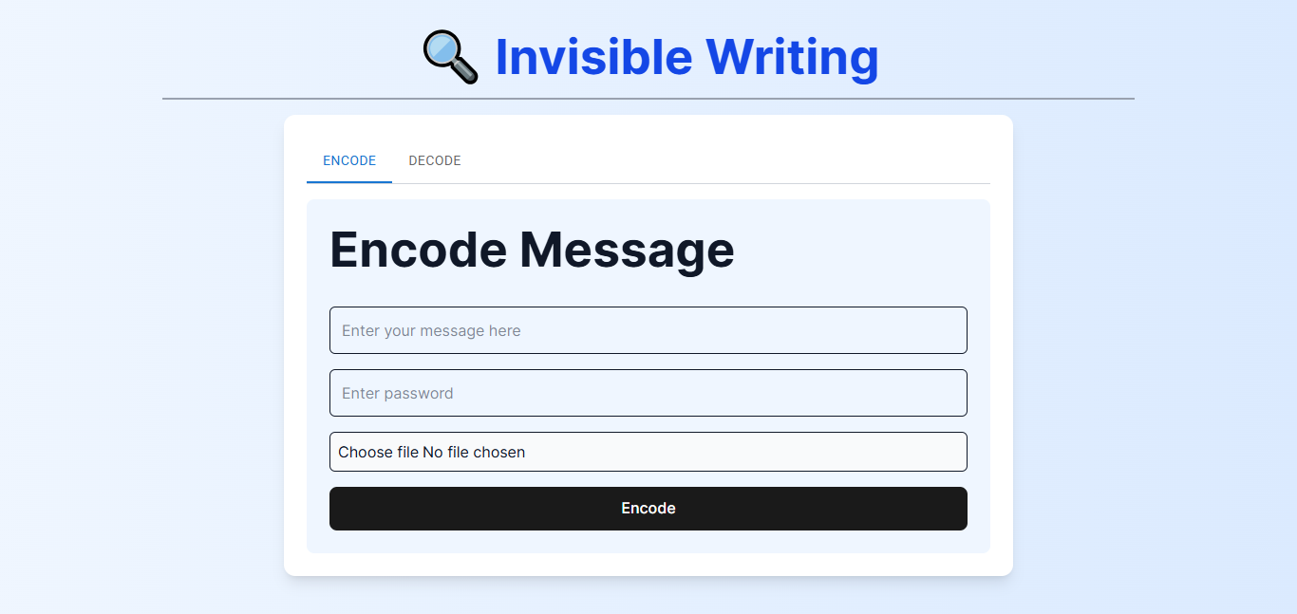
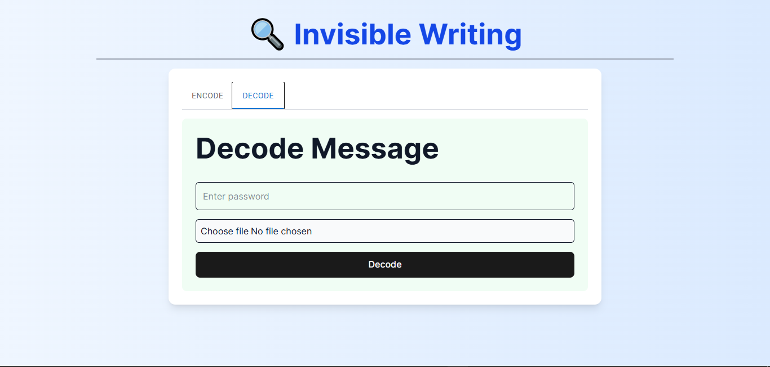
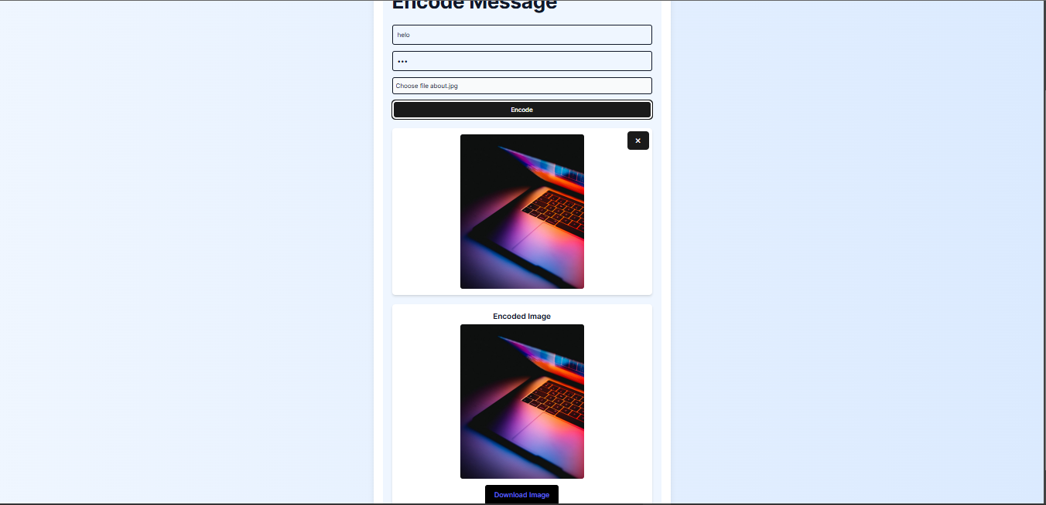
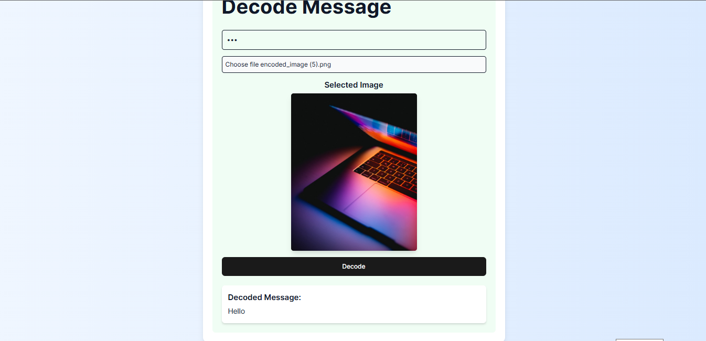
Results (Frontend – REACT JS)

Slide 8
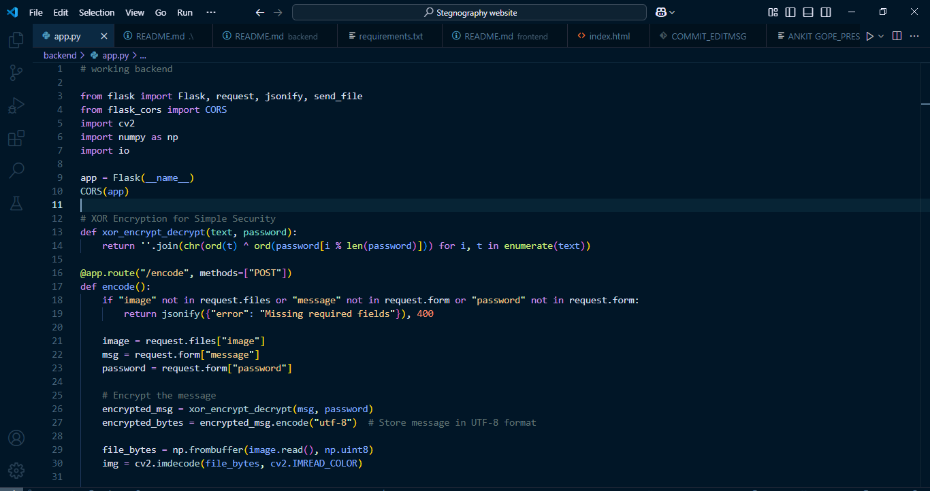
Results (BACKEND – PYTHON FLASK)

Slide 9
Conclusion
This steganography project provides a secure and user-friendly way to hide and extract messages within images using React and Flask. It demonstrates the power of data concealment, offering practical applications for privacy protection, secure communication, and cybersecurity learning. With its intuitive interface and seamless encryption/decryption process, the project makes steganography accessible to both technical and non-technical users.

Slide 10
GitHub Link
https://github.com/ankitgope/Invisible-Writing-React-Python.git

Slide 11
Future scope
Enhanced Security – Implement advanced encryption techniques to further secure hidden messages.
Support for Multiple File Types – Extend steganography to support audio, video, and text files.
Mobile & Web App Integration – Develop a mobile-friendly version or a browser extension for wider accessibility.
Cloud-Based Storage – Allow users to securely store and share encoded images via cloud services.
AI-Powered Steganalysis – Integrate AI-based detection and protection mechanisms against steganalysis attacks.
Block chain Integration – Use block chain for verifying and securing hidden data integrity.

Slide 12
THANK YOU

